Slide 1

Usability Testing 2
http://www.crossware.co.nz/
Planning and Reporting
From:.http://www.usability.gov/methods/test_refine/learnusa/testplan.html

Slide 2
Plan EVERYTHING
Use the template at http://www.usability.gov/methods/test_refine/learnusa/testplan.html
Fill in ALL the bits – even those that are completely obvious

Slide 3
Details
Scope
  Name of application or website
  How much or what are you testing
Purpose
  Broad
    “Can users complete the order?”
  Narrow
    “Can they find the shopping basket?”
Schedule & Location
  When and where
Sessions
  How long (less than one hour)
Equipment
  Exactly what equipment is needed
    Computer(what), video, Morae
Participants
  What type of people are you looking for
    Typical users?
    Convenience participants (e.g. students, other employees)

Slide 4
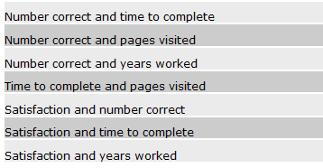
Details
Scenarios
  How many and what type of tasks (see next slide)
Metrics
  What will you measure/collect
    Errors
    Time
    Observations
    Questionnaire
Roles
  How many people do you need?
    Participant guide
    Observer

Slide 5
Task Design
Be specific
  “enrol in CS345 at the University of Auckland”
  “what lecture room(s) are CS345 lectures in?”
Record Completion Paths
  Step through the task yourself
    Record different routes to successfully complete
    Time yourself
  Note things you think are difficult or confusing
    You are, in effect doing a Heuristic Evaluation
    Remember these are notoriously inaccurate
  Do not show these to participants

Slide 6
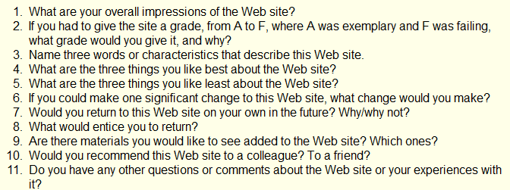
Questionnaire
The easiest way to gather satisfaction data is a questionnaire
There are several ‘standard’ questionnaires
  http://www.usabilitynet.org/trump/documents/Suschapt.doc
  http://www.w3.org/WAI/EO/Drafts/UCD/questions.html#posttest

Slide 7
Write a Script
Script the usability study EXACTLY
  Greeting
  Ethics
  Task instructions
  Questionnaire

Slide 8
Pilot Test
Try the whole thing out on one or two people
After first person fix obvious problems
  If very few corrections you can go straight to testing
  But it is much better to do a second pilot than discover major problems half way through

Slide 9
Analyse Results
Task time and success
Errors
  Wrong navigation
  Problems finding particular features
  ……….
Questionnaire analyse
  If less than 10 people show raw data and mean & standard deviation
  If more than 10 people box plots or scatter plots might be appropriate.

Slide 10
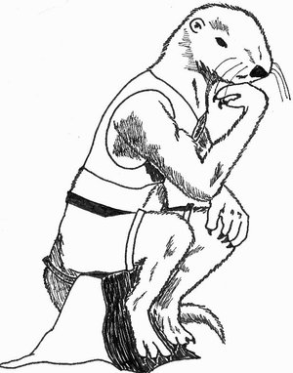
Think!
The big picture
What have you found?
What is worth fixing?
  Is there a business case?
How could the problems be alleviated?

Slide 11
Report
Document
  Detailed report of everything you have found
    Three formats here
      http://www.usability.gov/templates/index.html
    Remember numbers are very convincing compare
      Several people had trouble finding the shopping basket
      3 out of 7 people abandoned the task because they couldn’t find the shopping basket. For the other 4 the average time to find the shopping basket was 3.59seconds (longest 8.0 seconds)
Video
  Imagine clipping together the 7 people looking for the shopping basket icon … with puzzled looks on their faces!

Slide 12
Ethics
If you are doing a study with living (human or animal) participants in a university you will probably need ethics approval.
Quite a few companies have similar requirements
This is why for your assignment your participants are other class members.

Slide 13
Professionalism
Treat participants with respect
  Assume they are not idiots, it is the software that is wrong
Treat developers with respect
  They may have put their heart and soul into the product and worked overtime to get if finished for you to pull it apart
Make sure your report is
  Fair and accurate
  Tidy
  Free from grammar and spelling errors

Slide 14

In the real world
If you can’t do a ‘real’ usability test
  Get your mates, Mum, Dad, Aunty Flo to try it
Tune-in to your own usability experiences
  Note what was really easy
    that’s a sign of good usability
  Note what is annoying you
  Note when you are trying to do something you have done before and can’t remember how.

